Slide 1

Social Studies 6-12
Standards, Assessments, and Model Curriculum
Buckeye Local Schools
Some slides adapted from
Ohio Department of Education

Slide 2
Agenda
Session I
  Assessment Update
  Model Curriculum
Session II
  Introduction
  Text Complexity
  Additional Documents

Slide 3
New Generation of Assessments
“The state board of education, the superintendent of public instruction, and the chancellor of the Ohio board of regents shall develop a system of college and work ready assessments… The system shall replace the Ohio graduation tests…”
ORC § 3301.0712

Slide 4
New Generation of Assessments
More rigorous tests measuring student progress toward “college and career readiness”
Have common, comparable scores across member states, and across consortia
Provide achievement and growth information to help make better educational decisions and professional development opportunities
Source: Federal Register / Vol. 75, No. 68 / Friday, April 9, 2010 pp. 18171-85

Slide 5
New Generation of Assessments
Assess all students, except those with “significant cognitive disabilities”
Administer online, with timely results
Use multiple measures
Source: Federal Register / Vol. 75, No. 68 /
Friday, April 9, 2010 pp. 18171-85

Slide 6

Assessment Grants
In September 2010, the U.S. Department of Education awarded two grants to develop common assessments aligned to standards.
The recipients were…

Slide 7
Assessment Consortia
PARCC
SMARTER Balanced
Notes:
Partnership for Assessment of Readiness for College and Careers, or PARCC (most eastern states, led by Achieve)
SMARTER Balanced (mostly western states, led by West Ed)

Slide 8
Consortia Membership
Washington, DC
Hawaii
PARCC State
SMARTER Balanced State
Participating in Both consortia
Confidential and Proprietary. Copyright © 2009 Educational Testing Service.
Notes:
8
Ohio has participated in both consortia before making decision to formally join.

Slide 9
Ohio’s Decision
On November 15,
the Ohio State Board of Education voted to have Ohio join PARCC as a governing member.

Slide 10

PARCC:
Assessments Designed for Students in the 21st Century

Slide 11
PARCC
Consortia of 24 states + D.C.
English language arts and mathematics assessments
On-line testing
Item Types
  Multiple-choice items
  Extended-response items
  Technology-enhanced items
  Performance Task items
  Rapid reporting system to inform instruction and accountability
  Teachers involved in developing and scoring tests

Slide 12
PARCC
Components:
  Diagnostic (optional)
  Mid-year (optional)
  Performance Based (required*)
  End-of-year (required*)
  Listening/Speaking (required)
* contributes to summative score

Slide 13




PARCC Assessment Design
English Language Arts/Literacy and Mathematics, Grades 3-11
Flexible
Summative Components
Diagnostic Assessment
Mid-Year Assessment
Performance-Based
Assessment
End-of-Year /End-of-Course
Assessment
Summative assessment for accountability
Formative assessment
Speaking and Listening
  Source: Center for K-12 at ETS

Slide 14
  PARCC will enable Ohio to:
  Determine whether students are college- and career-ready or on track
  Compare performance across states and internationally
  Assess the full range of the Common Core Standards
  Measure the full range of student performance, including high and low performing students

Slide 15
  PARCC will enable Ohio to:
  Provide data during the academic year to inform instruction, interventions and professional development
  Provide data for accountability, including measures of growth
  Guide changes in instructional practice

Slide 16




PARCC Additional Tools
Professional Development
Public Communication
Teacher Resources

Slide 17
Rationale for PARCC
Close alignment with Ohio’s Race to the Top initiatives and state legislation
Established relationships with PARCC states
Achieve’s* work on Algebra I and II End-of-Course assessments led by Ohio
*PARCC’s project manager partner

Slide 18
Ohio Assessment Timeline
June 2010
  State Board Adopted Common Core Standards
March 2011
  State Board Adopted Model Curriculum
2012- 2014
  Assessment Development
    Test Development
    Field Test
    Standards Setting
2014-2015
  Assessments Operational – First Administration

Slide 19

Where are we now?
Existing State
Assessments –
Transitional
Years

Slide 20
The Transitional Years
Kindergarten Readiness Assessment – Literacy (KRA-L)
  Development started to expand content areas:
  Mathematics
  Physical well-being and motor development (including adaptive skills)
  Social and emotional development

Slide 21

The Transitional Years
K-3 Diagnostics
  Ready for districts to use in school year 2012-13
  Will not be available for viewing prior to the 2012-2013 school year
OTELA
Required for students identified as ELL
Process started to realign to CCSS
Decision needed on developing new ELP to assess realigned to CCSS
Notes:
2001 Ohio Academic Content Standards are assessed – KRA-L has started to realign

Slide 22
The Transitional Years
K-3 Diagnostics
  Process has started to realign to CCSS
  Minor modifications to fill gaps
  Ready for districts to use in school year 2012-13

Slide 23
The Transitional Years
Ohio Achievement Assessments (OAA)*
  Continue to be administered until ORC is revised to address end date
  Ohio Graduations Tests (OGT)*
  Continue to be administered
  ORC states OGT will be phased out and replaced with new system (national standardized assessment and end-of-course exams) but no timeline given
  *OAA and OGT assess the standards adopted in 2001 and 2002

Slide 24
The Transitional Years
HB153 July 2011
Restates from HB1
Elementary, Middle and High School
  Combine reading and writing into a single English language arts assessment
  Establish 3 performance levels (instead of 5)
Notes:
These changes will be implemented with the new assessment system in 14-15.

Slide 25
The Transitional Years
HB153 July 2011
Changes
High School
National Standardized Assessment
Series of End of Course exams
Senior Project
Notes:
A change in Ohio law could align these components with the PARCC system of new assessments.

Slide 26
The Transitional Years
Alternate Assessment for Students with Disabilities (AASWD) – alternate OAA and OGT for students with severe cognitive disabilities
  Development has started for online assessment
  No longer the portfolio format – students will be given tasks, scores recorded by test administrator online
  Operational spring 2013

Slide 27
Revised Standards
Are not stand-alone reform
Will take us half-way up the mountain
TO REACH THE SUMMIT
Effective curricula
Effective professional development
Effective instruction

Slide 28
What Should
Districts Do Now?
Become familiar with:
  Common Core State Standards
  Revised standards
  Model curricula for each
Utilize crosswalks and comparative analyses to identify changes in content and levels of rigor
Assure that all students have access to high quality instruction and challenging curriculum
Develop support structures for struggling students
Watch for new opportunities and resources
Be skeptical of easy alignment and quick fixes

Slide 29
District Next Steps
2010-2011
Build awareness of new standards
2011-2012
2012-2013
Participate in performance based and formative assessment pilots
2013-2014
Integrate standards and curricula into district curricula and teachers’ course planning
Integrate performance tasks in course activities
Participate in creating model curricula
Continue formative instruction PD
Prepare for online testing
Complete formative instruction PD
Conduct crosswalk activities
Revise curriculum based on analysis findings
Begin using new standards in grades K-2
Initiate formative instruction PD
Conduct curriculum gap analysis
Introduce model curricula

Slide 30
House Bill 1:
Model Curriculum
…the state board shall adopt a model curriculum… The model curriculum shall be aligned with the standards, to ensure that the academic content and skills specified for each grade level are taught to students, and shall demonstrate vertical articulation and emphasize coherence, focus, and rigor. (Adopted March 2011)
ORC §3301.079(B)
Notes:
It must be noted that as we move into this transition period we are as engaged as ever because we know this work is what is really poised to impact teaching & learning in our state.
Adopted in March 2011

Slide 31
Goals of Model Curricula
To help teachers:
Reach a shared understanding of the intent of the Common Core and revised standards
Provide differentiated instruction for diverse learners
Find resources that match higher expectations and support technological applications
Notes:
The Model Curricula are web-based tools, aligned to the standards, that:
Provide in-depth information about “what” should be taught by grade level, grade band and course
Include instructional strategies and resources
Provide ways to evaluate student understanding
Provide guidance on specific elements within a subject area
The MC was created using the same process as that of the standards revision in Ohio: teams of content experts at ODE, teachers, administrators, higher ed representatives, content-related organizations. The MC was also put up for public feedback and revised accordingly.

Slide 32
Model Curricula
774 Model Curricula have been developed across all four content areas:
  A model curricula for each cluster in mathematics for grades K-12
  A model curricula for each topic in English language arts for grades K-12
  A model curricula for each content statement in science and social studies for grades PreK-12
Notes:
There are 774 model curricula currently developed across the four content areas.

Slide 33
Model Curricula Components
Content Elaboration
  Detailed information on the content and skills addressed at a grade level, grade band and course
Expectations for Learning
  Recommendations for how students may be evaluated
    Applies only to science and social studies

Slide 34
Model Curricula Components
Instructional Strategies and Resources
  Guidance and support for instructional, curricular and assessment design
  Links to resources for diverse learners
Content Specific Sections
  Address elements specific to a subject area, such as
    Misconceptions (science and mathematics)
    Enduring Understandings (English language arts and social studies)

Slide 35
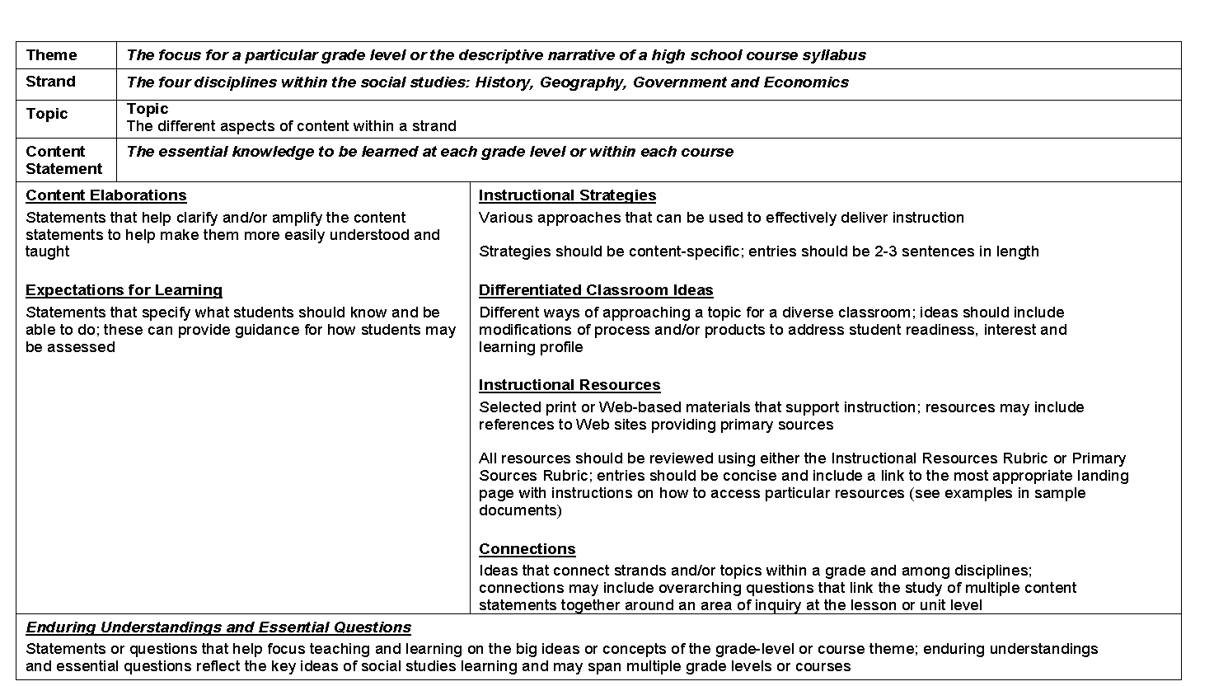
Model Curriculum Template
Content Elaborations
Instructional Strategies and Resources
Expectations for Learning
Content Specific Sections
Notes:
Content Elaboration
In-depth information about “what” should be taught
Expectations for Learning
Recommendations for how students may be evaluated
Applies only to science and social studies
Instructional Strategies and Resources
Guidance and support for instructional, curricular and assessment design
Links to resources for diverse learners
Content Specific Sections
Address elements specific to a subject area, such as
Misconceptions (science and mathematics)
Enduring Understandings (English language arts and social studies)

Slide 36
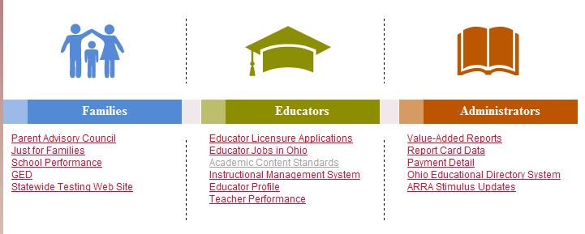
Standards and Model Curricula Resources
From the ODE homepage at education.ohio.gov:
Click “Academic Content Standards”
Then choose Revised Academic Content Standards and Model Curriculum Development

Slide 37
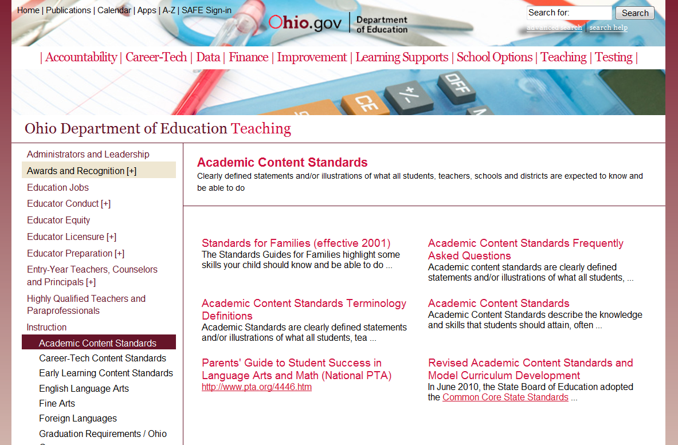
Notes:
Next, select here at the arrow.

Slide 38
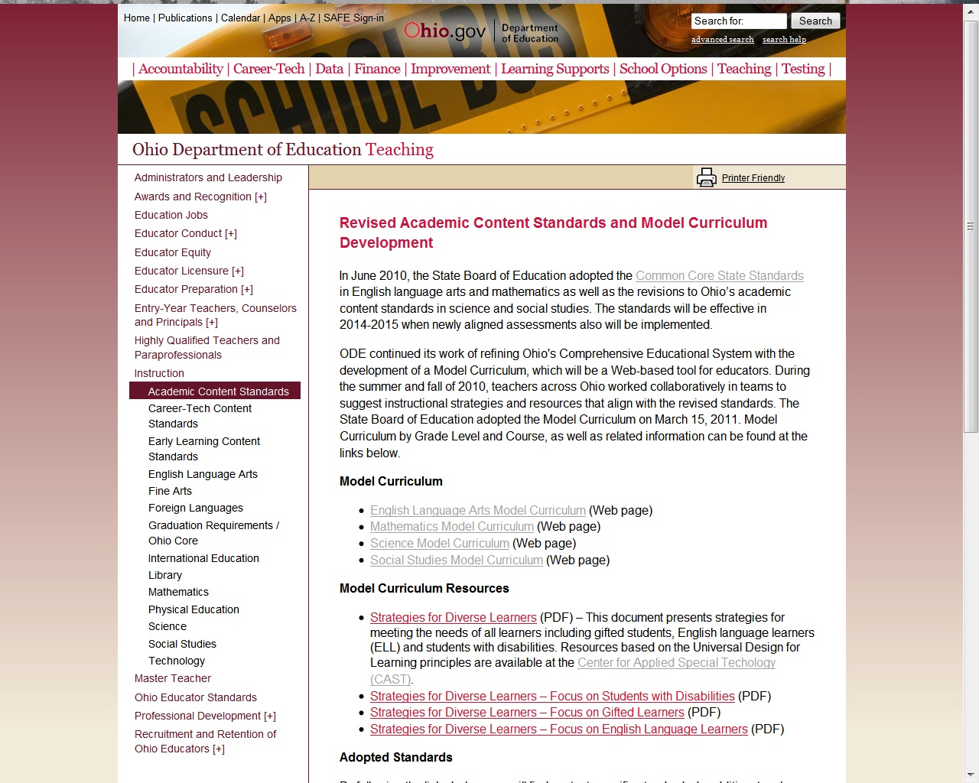
Notes:
Here is the ODE website for the Model Curriculum. Click here to access Social Studies.

Slide 39
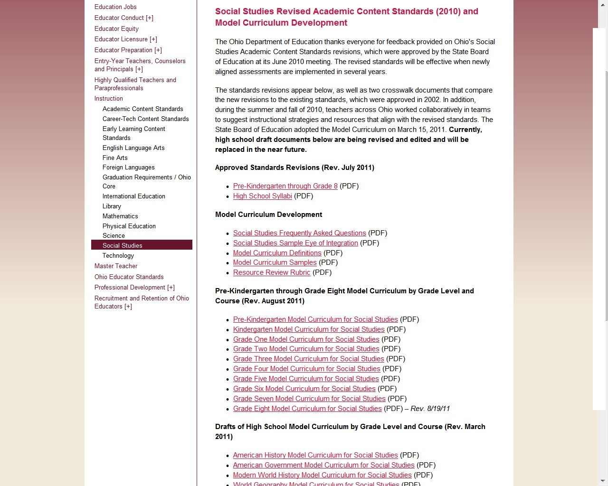
Notes:
Teachers can download and configure the Model Curriculum for the grade or high school course they need for planning.

Slide 40
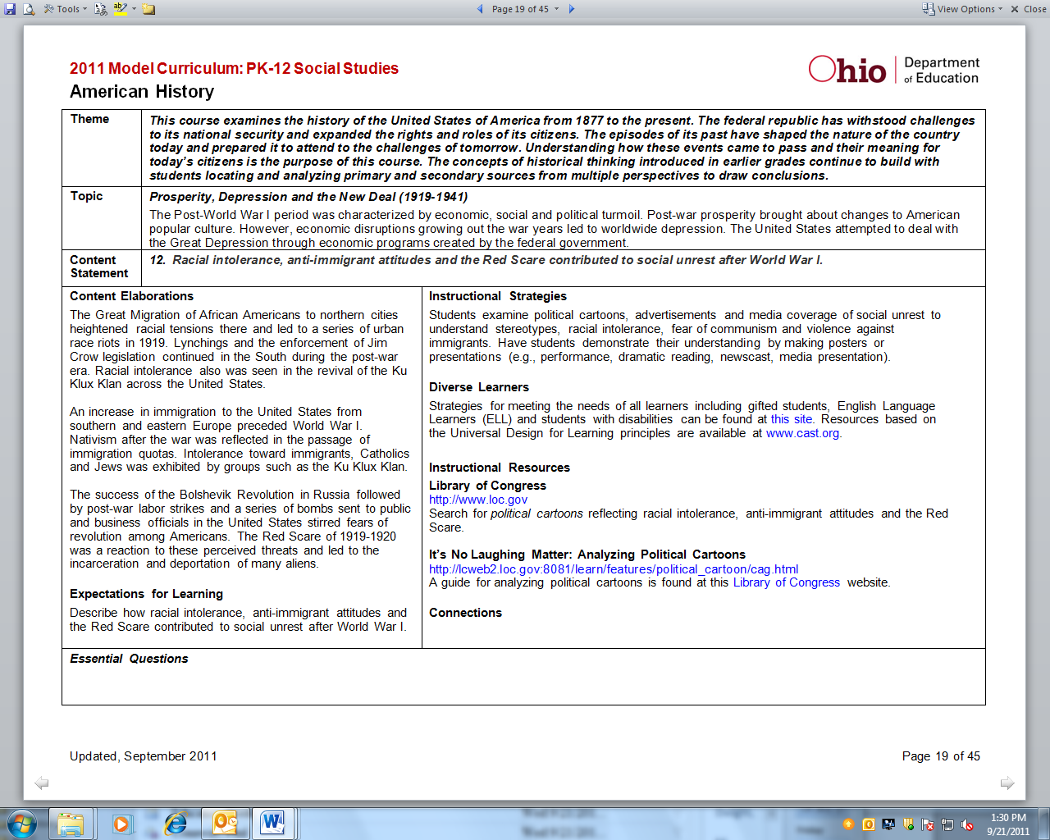
Notes:
Here is the Model Curriculum for Content Statement twelve for American History. Every content statement is aligned to a model curriculum document like the one shown in this slide. Now let’s review the components.
(Click) Here is the theme which is a descriptive narrative of this high school course. (Click) Next is the topic that describes the different aspects of content within the strand.
(Click) The Content Statement identifies what students should know.
(Click) Content Elaborations help clarify and/or amplify the content statements to help make them more easily understood and taught.
(Click) Expectations for Learning specify what students should know and be able to do. Content Statements, Content Elaborations and Expectations for Learning are what we refer to as “static” – that is, they will not change and will contribute to the development of assessments at the local and state-wide levels.
Now, let’s look at what we refer to as the “fluid” part of the Model Curriculum. These will periodically change with input from Ohio teachers.
(Click) Instructional Strategies,
(Click) Strategies for Diverse Learners and
(Click) Instructional Resources will provide guidance and support for local instructional and curricular design. This will include content-specific instructional ideas, suggestions for aligned resources, differentiated classroom ideas, and ways for students to demonstrate their learning. Although not yet developed for this content statement, Connections and Essential Questions will help teachers plan instruction around big ideas and to connect student learning within and across disciplines.

Slide 41
Session II
  Introduction
  Text Complexity
  Additional Documents

Slide 42
Ohio’s Academic Standards
“The standards shall specify… the core academic content and skills… that will allow each student to be prepared for postsecondary instruction and the workplace for success in the twenty-first century.”
ORC § 3301.079(A)(1)(a)

Slide 43
Are Ohio Students
Ready for College?
ACT, “The Conditions of College & Career Readiness, Class of 2010: Ohio.”
Notes:
Note: the red bar indicates that only 28% of Ohio test-takers were college-ready in ALL four areas. This figure is not an average of the proceeding four.

Slide 44
Jobs Will Require More Education & Training
NO COLLEGE REQUIRED
COLLEGE REQUIRED
Source: Georgetown Center on Education and the Workforce, 2010.
Notes:
This information in this slide was taken from Carnevale, Anthony P., Nicole Smith, and Jeff Strohl, “Help Wanted: Projections of Jobs and Education Requirements Through 2018”, Georgetown Center on Education and the Workforce, 2010.
While the original article breaks down the categories of “college required” and “no college required” into more detailed categories (i.e. some college, associates, bachelors, masters, etc vs. high school dropouts and high school graduates), we have simplified it to communicate the point that most careers today and in the future will require additional postsecondary training and education. This is why it is so critically important to prepare our students to be college- and career-ready.

Slide 45

What is College and Career Readiness?
Being qualified for:
  A degree-granting postsecondary education, without remediation
  A chosen career, ready for advanced training.
Notes:
Recent PARCC newsletter puts it well:
“Despite the mounting evidence, there continues to be some resistance to the college- and career-ready agenda, largely stemming from a misunderstanding that it means that all students should go to four-year colleges. In fact, being "college- and career- ready" is about graduates having options and choosing their own career path. To do so, graduates must leave high school ready—that is, without the need for remediation—for additional education and/or training whether that is at a community college, technical college, apprenticeship or certificate program or a four- year college degree.” June 30, 2011
41% students enter post-secondary experpienc

Slide 46
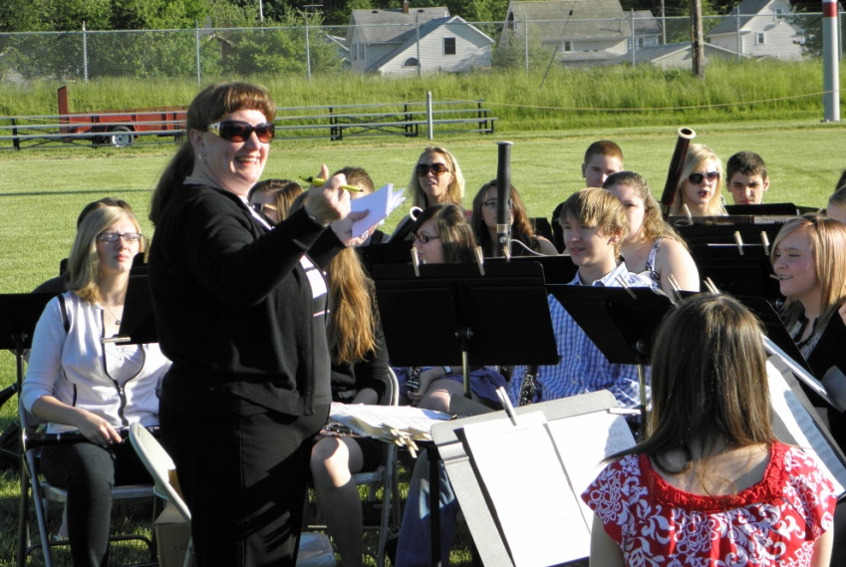

Text Complexity
It is all about
the band and the range
Notes:
Well…the point is

Slide 47
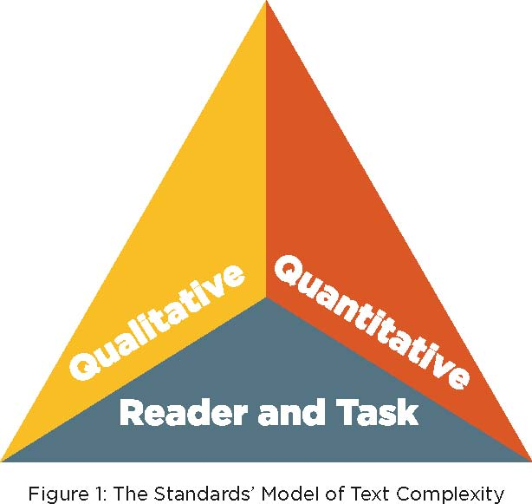
The Standards’ Model of Text Complexity
Common Core State Standards for English Language Arts & Literacy in History/Social Studies,
Science, and Technical Subjects, Appendix A: page 4 http://www.ode.state.oh.us/GD/Templates/Pages/ODE/ODEDetail.aspx?page=3&TopicRelationID=1699&ContentID=86942

Slide 48
Qualitative Dimensions of Text Complexity
In the Standards, qualitative dimensions and qualitative factors refer to those aspects of text complexity best measured or only measurable by an attentive human reader, such as levels of meaning or purpose; structure; language conventionality and clarity; and knowledge demands.

Slide 49
Quantitative Dimensions of Text Complexity
The terms quantitative dimensions and quantitative factors refer to those aspects of text complexity, such as word length or frequency, sentence length, and text cohesion.
Notes:
They are difficult if not impossible for a human reader to evaluate efficiently, especially in long texts, and are thus today typically measured by computer software.

Slide 50
Lexile Framework® for Reading Study
Summary of Text Lexile Measures
Interquartile Ranges Shown (25% - 75%)
1600
1400
1200
Text Lexile Measure (L)
1000
800
600
High
School
Literature
College
Literature
High
School
Textbooks
College
Textbooks
Military
Personal
Use
Entry-Level
Occupations
SAT 1,
ACT,
AP*
* Source of National Test Data: MetaMetrics

Slide 51
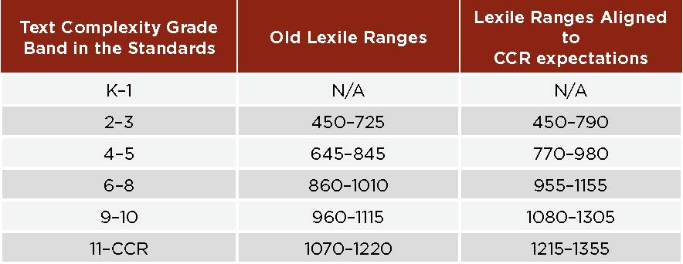
Lexile Ranges
Text Complexity Grade Bands and Associated Lexile Ranges (in Lexiles)
⁴RAND Reading Study Group. (2002). Reading for understanding: Toward an R&D program in reading comprehension. Santa Monica, CA

Slide 52
Reader and Task Considerations
Variables specific to particular readers (such as motivation, knowledge, and experiences) and to particular tasks (such as purpose and the complexity of the task assigned and the questions posed) must also be considered when determining whether a text is appropriate for a given student.
Notes:
Such assessments are best made by teachers employing their professional judgment, experience, and knowledge of their students and the subject.

Slide 53


Ohio’s Academic Standards
  English language arts
  Mathematics
Ohio Revised Standards
  Science
  Social Studies
Notes:
Common Core State Standards and Ohio’s Revised Standards were adopted in Ohio in June 2010

Slide 54
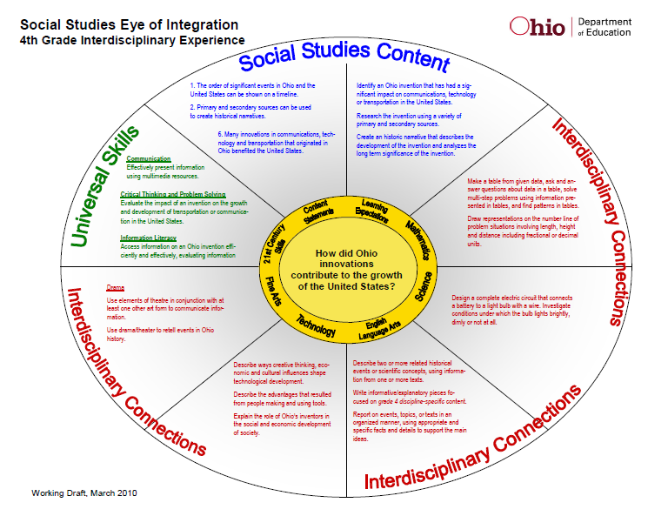
Eye of Integration

Slide 55
Organization of the
Social Studies Standards
Strands: the four disciplines within the social studies
Themes: the focus for a particular grade level or the descriptive narrative of a high school course syllabus
Topics: the different aspects of content within a strand, including skills topics
Content Statements: the essential knowledge to be learned at each grade level or within each course

Slide 56
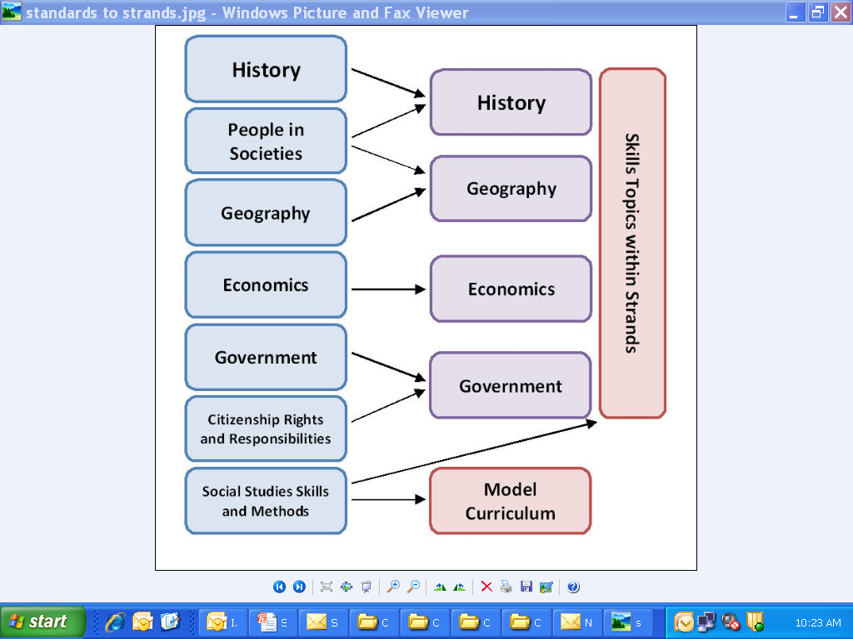
New Social Studies Strands
Notes:
In an effort to streamline the standards, the seven standards from the 2002 version have been collapsed into four strands.
The blue shaded areas on the left side of the diagram indicate the current standard structure and the four purple areas on the right side indicate the proposed strands. We go from seven standards to four strands. This chart also reflects the inclusion of skills into each strand.
The People in Societies standard has been incorporated in both the History and Geography Strands.
The Government and Citizenship Rights and Responsibilities standards have been combined into one strand.
Some of the skills in the previous Social Studies Skills and Methods standard are included in the strands and evident in the Model Curriculum.

Slide 57


Ohio’s Academic Content
Standards: Social Studies
Strands:
  History
  Geography
  Government
  Economics
Skills:
  Historical thinking
  Spatial thinking
  Civic participation
  Economic decision making
  Financial literacy
Notes:
Each of the four strands includes a skills topic. Financial literacy is also included in economics as a skills topic (as per Ohio Revised Code requirement).

Slide 58
Revised Scope and Sequence
Pre-K | The Classroom Community
Kindergarten | A Child’s Place in Time and Space
Grade 1 | Families Now and Long Ago, Near and Far
Grade 2 | People Working Together
Grade 3 | Communities: Past and Present, Near and Far
Grade 4 | Ohio in the United States
Grade 5 | Regions and People of the Western Hemisphere
Grade 6 | Regions and People of the Eastern Hemisphere
Grade 7 | World Studies from 750 BC to 1600 AD: Ancient Greece to the First Global Age
Grade 8 | U.S. Studies from 1492 to 1877: Exploration through Reconstruction
Notes:
The revisions in “Scope and Sequence” are reflected mainly in grades 4-6, with some changes to time periods in grades 7 and 8.

Slide 59
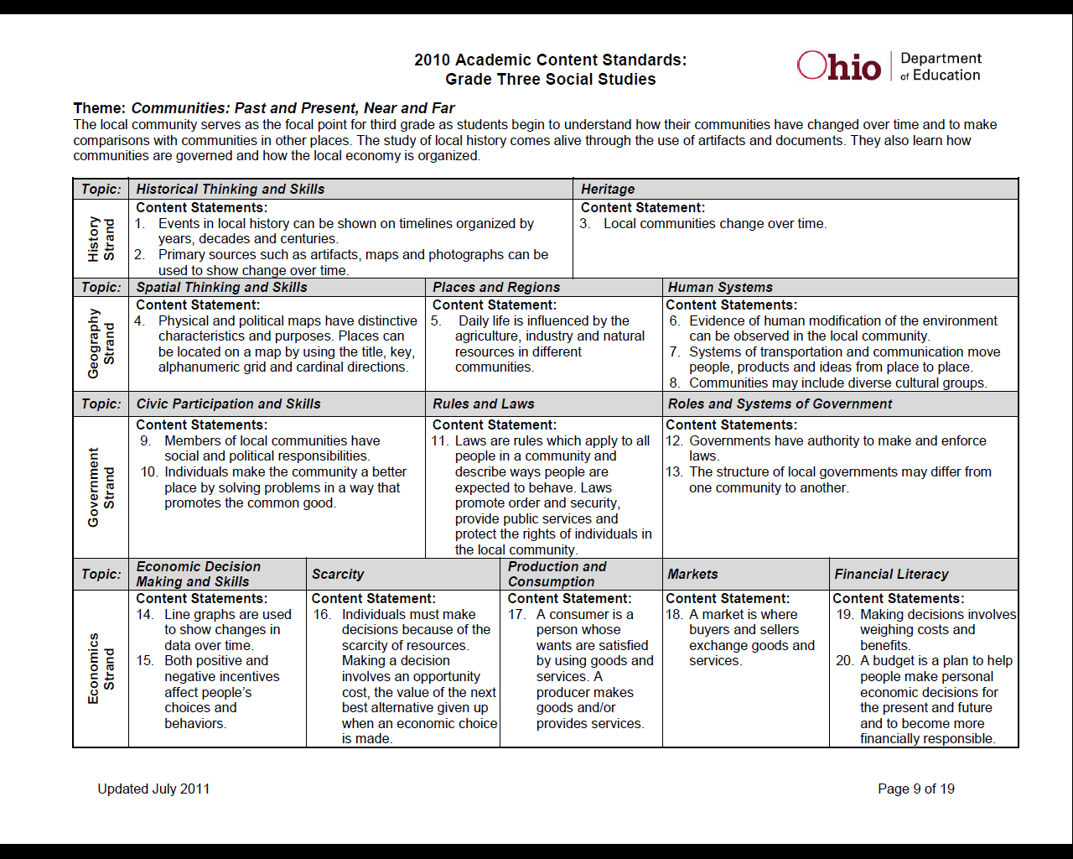
Social Studies Academic Content Standards Format
Themes
Grade
Descriptions
Strands
Skills
Content Statements
Notes:
Here is a sample format of the standards for grades PK-8. This is for grade three.
(Click). First we see the Theme. For grade 3 it is Communities: Past and Present, Near and Far. (Click) Next is the Grade Description.
(Click) On the left side are the Strands. This one points to the Geography strand. (Click) The Topics are different aspects of content within a strand and are integrated within the four strands. (Click) The Skills are topics introduced at the beginning of each strand and progress from grade to grade.
(Click) Content Statements are essential knowledge to be learned at each grade level or within each high school course. Note that they do not begin with performance verbs.

Slide 60
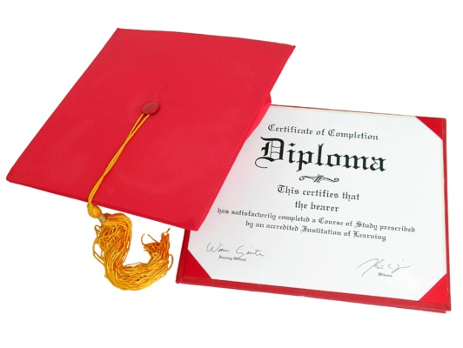

High School Course Syllabi
Required for graduation (Ohio Revised Code)
American History
American Government
Electives
Modern World History
Economics and Financial Literacy
Contemporary World Issues
World Geography
Notes:
The high school social studies syllabi contain a manageable number of topics per course with aligned content statements and could form the basis for end-of-course exams in a limited number of courses.
The Ohio Revised Code requires three units of social studies credit for graduation from high school, including one half unit of credit in American history and one half unit of credit in American government.
A World Geography course was added as a response to the public feedback.
The inclusion of particular courses in the revised standards is not meant to require that all of these be offered, or to limit the choice of additional courses which districts may choose to offer in their social studies programs. And, no decision has been made at this time connecting specific courses to end-of-course exams.

Slide 61
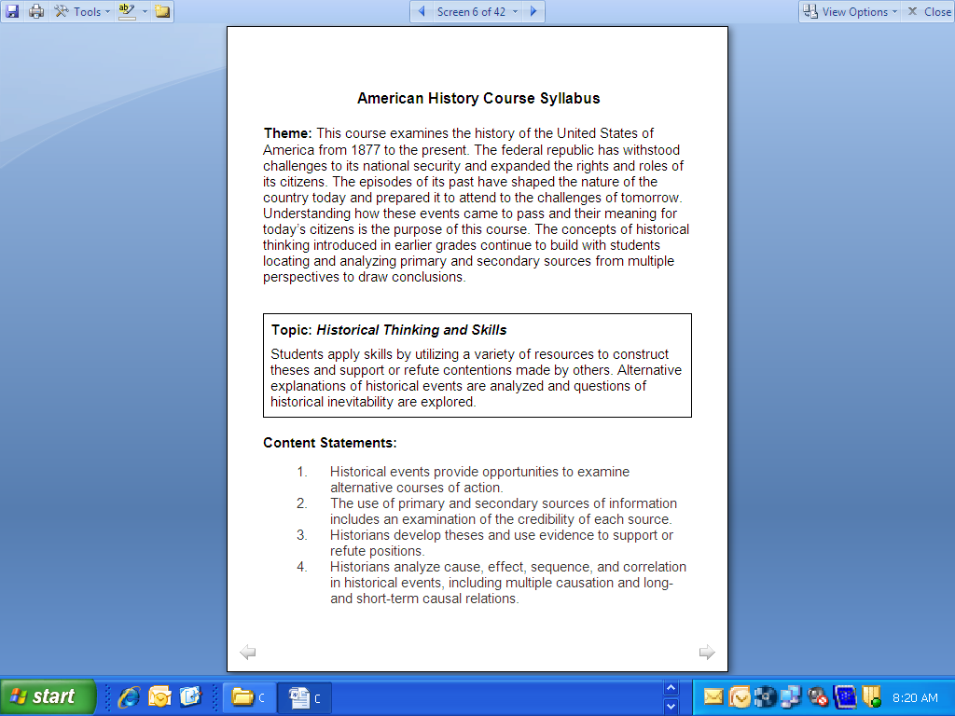
Goal 3: Create High School
Course Syllabi
Notes:
A third goal was to create course syllabi for high school courses as stipulated in Amended Substitute House Bill 1. Each high school syllabus, like this one for American History, contains a course theme and broad topics which are further clarified with content statements. The high school courses have a similar structure to the revised PK-8 grade levels. They spell out themes, topics and content statements.

Slide 62
Crosswalk Analysis Example
Topic: Government and the Economy
15 | The federal government uses spending, and tax policy to maintain economic stability and foster economic growth. Regulatory actions carry economic costs and benefits. | Grades 9-10: ECON B: Explain how the U.S. government provides public services, redistributes income, regulates economic activity, and promotes economic growth and stability. | Some new content The focus is on the way federal government spending and tax (fiscal) policy is used to bring about change in the nation’s economic condition and identifying the costs and benefits of regulatory actions of government.
 |  | Grades 11-12, ECON D: Analyze the role of fiscal and regulatory policies in a mixed economy.
Will use this document on February 28th.
Notes:
This example is for American Government Content Statement 15 under the Government and the Economy topic.
The crosswalk indicates that there is some new content. Looking at both benchmarks with their related gli’s as well as the content statement and its accompanying Content Elaborations and Expectations for Learning, one is able to draw conclusions about the change in focus and new content.

Slide 63
Goal 4: Provide Clear Progression of Content from Grade to Grade
Grade Four, Content Statement 21:
  The Ohio Constitution and the U.S. Constitution separate the major responsibilities of government among three branches.
Grade Eight, Content Statement 20:
  The U.S. Constitution established a federal system of government, a representative democracy and a framework with separation of powers and checks and balances.
High School, American Government, Content Statement 5:
  As the supreme law of the land, the U.S. Constitution incorporates basic principles which help define the government of the United States as a federal republic including its structure, powers and relationship with the governed.
Notes:
One of the goals of the standards revision project was to create a more clear progression from grade to grade. One of the tasks of the working group was to check for horizontal and vertical alignment. Vertical alignment includes a progression of a set of related content or skill objectives from one grade level to the next. For example, here is how the U.S. Constitution is introduced and progresses through two grades and in a high school course:
For grade four, content statement 21:
The Ohio Constitution and the U.S. Constitution separate the major responsibilities of government among three branches.
In grade eight, content statement 20:
The U.S. Constitution established a federal system of government, a representative democracy and a framework with separation of powers and checks and balances.
In the high school American Government course, content statement 5:
As the supreme law of the land, the U.S. Constitution incorporates basic principles which help define the government of the United States as a federal republic including its structure, powers and relationship with the governed.

Slide 64
Goal 5: Meet the Needs of Students for the 21st Century
The social studies academic content standards directly address the 21st-century themes of:
Civic literacy;
Financial and economic literacy; and
Global awareness.
Notes:
The social studies standards directly address the 21st-century skills of civic literacy, financial and economic literacy and global awareness.
Links to other 21st-century skills such as problem solving, communication, media literacy and leadership are more fully developed in the model curriculum.

Slide 65
21st Century Skills
Life and Career Skills
Leadership & Responsibility
Information, Media and Technology Skills
Information Literacy
Learning and Innovation Skills
Critical Thinking
Productivity & Accountability
Flexibility & Adaptability
Initiative & Self-Direction
Social & Cross-Cultural Skills
Media Literacy
Information, Communications & Technology Literacy
Communication
Research
Problem Solving/Design
Collaboration
Meta-cognition
Creativity
Innovation
Notes:
Our content specialists, in concert with educational leaders throughout the state, will help colleagues see and understand the presence of these skills in the standards and provide opportunities to note in the strategies and resources sections of the model curriculum how these skills can enhance teaching and learning in our state.
*Please note the items in RED indicate the latest revision of H.B. 153 which deleted those items. (5/4/11)

Slide 66
The Social Studies Signal
The Ohio Social Studies Signal newsletter provides timely information to social studies educators regarding important news from ODE, professional development opportunities and classroom resources.
http://lyris.ode.state.oh.us/cgi-bin/lyris.pl?enter=Socialstudies
Notes:
The ODE social studies team sends the Signal out monthly through a list serve of teachers, curriculum coordinators, higher education educators and others is interested in the latest news on social studies in Ohio.

Slide 67

Exit Slip
With your grade level team, work together to address the following:
What are the two most important things you learned today?
2. What questions do you still have?
3. As a result of your learning today, what changes can you make in your instruction now?

